Slide 1
Programmed Instruction
History of Ed Tech
EDC&I 510

Slide 2
Before we begin…
(and while your minds are still fresh!)
In small groups, identify two aspects of programmed instruction that are still with us today

Slide 3
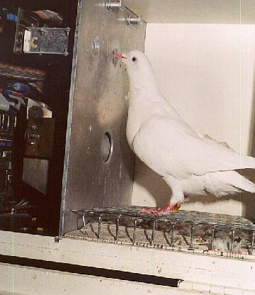
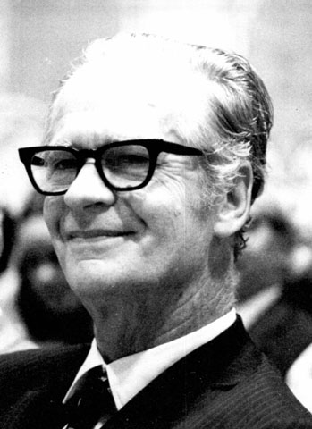
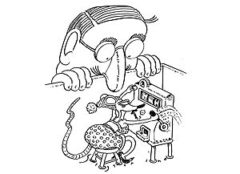
When we think of PI…
Mostly if people have any association, it’s with B.F. (Burrhus Frederic ) Skinner (1904-1990)

Slide 4
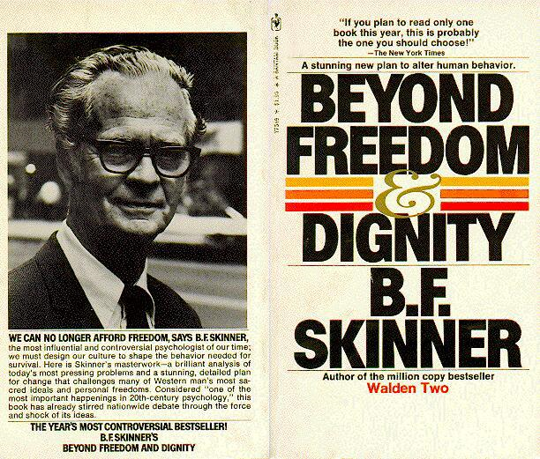
Skinner
Skinner was mostly a good guy, and he won significant awards for his thoughtful (many would say philosophical) commentaries of education, learning, and character development

Slide 5
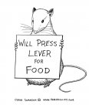
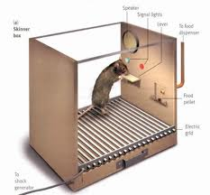
Skinner’s Fame
Grew out of classical psychological research on the “operant” – a conditioned (created) response to a particular stimulus
Pigeons, rats were subjects
The “Skinner Box”⇑

Slide 6
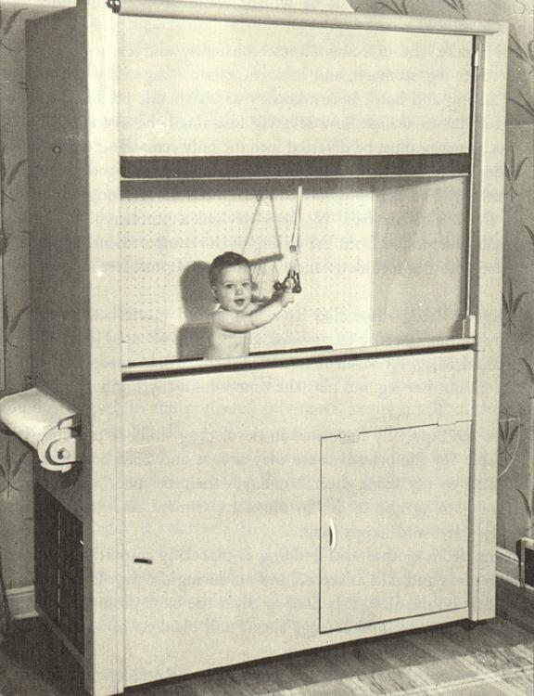
But…
When he moved from working with animals to working with humans, many became concerned

Slide 7
Where Did These Ideas Come From?
Not all unique to Skinner
Beginning around 1900, efforts in psychology to study individual learning, development in a more “scientific” way
Observable behavior became the gold standard (i.e., not “internal states,” “dispositions,” etc.)
WW I drove some efforts – need to test large numbers of people quickly
Also rise of the College Board and attempts to find a common standard for comparing college entrants

Slide 8
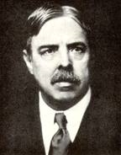
Edward Thorndike
Educational psychologist at Columbia University Teachers College (1874-1949)
“If, by a miracle of mechanical ingenuity, a book could be so arranged that only to him who had done what was directed on page one would page two become visible, and so on, much that now requires personal instruction could be managed by print. ” (1912)

Slide 9
Thorndike’s Image of Learning
Recency
The most recent response will likely govern the next recurrence
Effect
Likelihood of a response recurring is governed by its consequence or effect -> reward or punishment
Exercise
Stimulus-response associations are strengthened through repetition.

Slide 10
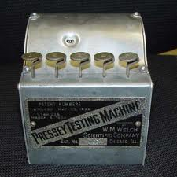
Sidney Pressey
Educational psychologist at Ohio State U. (1888-1979)
Used the term “testing machine”
“the procedures in mastery of drill and informational material were in many instances simple and definite enough to permit handling of much routine teaching by mechanical means.“ (1926)

Slide 11
Advent of the Teaching Machine
Skinner designed and advocated for use of teaching machines to generate more effective learning

Slide 12
Key Principles
Immediate reinforcement
Knowledge of whether one got right answer or not; in some cases, more sophisticated feedback
Individual pacing
Learner moved at own speed; classes could be more individualized
Active response
Learner needed to actually do something, not merely read, memorize

Slide 13
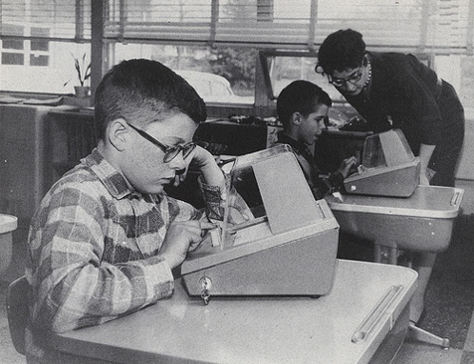
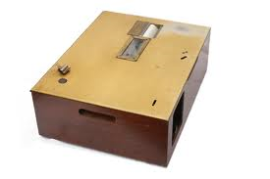
Many Variations
“Techno-tutor,” “Robo-teacher,” etc.
(Classroom teachers generally hated these terms)
Most worked via one-use paper programs printed on sheets or rolls

Slide 14
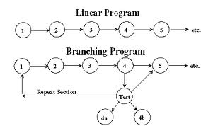
Quick Up-Take
Caught on in many disciplines, many subjects
Seen as a cheaper way to cope with increasing numbers of students in US schools at the time.
Lots of research conducted on a variety of programming variables
Considerable enthusiasm from military, corporate training community

Slide 15
But….
(And it was a very large “but”)
This was RADICALLY DE-CONTEXTUALIZED LEARNING
(And now we know that context makes a huge difference…)
Lack of variety in display and response mechanisms led to rapid boredom by users
The skill required to construct programs was much greater than anticipated, and many were of low quality

Slide 16
Later
The move on to “the next device” (TV) in 1960s shunted PI to the sidelines
Rise of computers (Suppes=pioneer) in 70s-80s allowed more variety, creation of branching programs, etc.
Rise of cognitive psychology, learning sciences, constructivism (in 90s-00s) made it easier to understand PI’s problems

Slide 17
But there was a residue…

Slide 18
What Mattered
Decomposition of instruction
Step-wise progression
Active response and immediate feedback
Branching
Led to much stronger focus on individualization of instruction (still with us today)
Behavioral objectives (and specification of learning outcomes)
“Machine learning” (individual interacts with a device)

Slide 19
What Didn’t Matter So Much
Precision of steps and type of feedback (large variation with subject and level of learners)
Feedback (didn’t always shape behavior and learning in desired ways)
BUT: Feedback remains a topic of fascination for many researchers and continues to be part of the research on gaming, e-learning, and so on

Slide 20
Questions that Faded with Time
Branching
No longer tough to do, but we still don’t always know how
The Behavioral Project
Current “socio-cultural” view of learning = less individual, more nuanced
Can people learn directly from devices?
Sure; but what really grabs ‘em?

Slide 21
What Was Left Unanswered
Motivation
Often was not as high as designers assumed
Branching
Value, place of learner control still not resolved, although computers made branching trivial task
Structure of knowledge
Not as precise for many fields as Skinner had assumed
Assessment and feedback
Its place in the overall scheme of learning (part of a larger philosophical debate about purposes of education)

Slide 22
The Legacy
We began to get more precise in thinking about what we want as results, outcomes of education (cf. “Backwards Design”)
We began to think about education in terms of learning, not in terms of instruction
We began to think about learning environments in terms of design (rather than simply repetition or enactment of prior patterns)

Slide 23
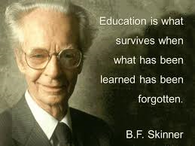

Slide 24
Questions for Discussion
Holland chapter: connection between variables, approaches described there and those used in online or computer-based training today?
Mager: Do we still use “behavioral objectives” today? How/where? How different now?
Suppes: To what extent has his vision for computing in education been realized?

Slide 25
Questions for Next Week (10/26)
Chu & Schramm
Compared with the research on film, where does the research on TV match up? Where is it different?
What was “conventional instruction” in the studies summarized?
What were some of the underlying motivations for using TV in instruction?

Slide 26
Clark (‘83, ’94)
“Mere vehicles…” Do you agree with this position (83, p. 445)? Why or why not?
Media attribute research (p. 451) – Are we still doing this sort of research today? Examples?
Invested mental effort (IME) work (p. 455) – Interaction with student ability levels – implications?
Efficiency vs. effectiveness (94, pp. 25-27) – Do you agree with Clark’s views?
Cf.: McLuhan’s ideas

Slide 27
Clark (‘01)
Cognitive load and mental effort (267-279) – Implications for other applications, subjects
How to design to prevent “Overconfidence default” (280-82)?
Motivation processes (“yin” and “yang”) – picture of learners and their motivations that emerges?

Slide 28
Salomon & Perkins
Effects with, of, and through technology –Examples of each?
Learning benefits of each?
“Effects through” and notion of activity systems: How does this match with current uses of social media? With support for learning ?

